Slide 1
Complex Numbers
Milton Math Team September 5, 2013

Slide 2
What is a Complex Number?
Solve the equation for x:
x² + 1 = 0
What do you get? What can you call your answer?
.…an imaginary number!

Slide 3
Pure Imaginary Numbers
If we multiply i by a real number like 2 or π, we get a number like 2i or πi; there is no way to simplify this product.
Numbers like these are called pure imaginary numbers.

Slide 4
Complex Numbers
The so-called complex numbers are just the numbers you get when you add a real to an imaginary.
Examples:
  2 + 6i
  -7 + 5i
  ½ – 4i
General form: a + bi

Slide 5

Practice: Adding & Subtracting
What is the sum of the following?
Find the general formula for the sum:

Slide 6
Practice: Multiplying
Multiply (3 + 4i) by (-3 + 8i). Remember that i² = -1.
Answer: -41 + 12i

Slide 7

Practice: Dividing
When we divide two complex numbers, we clear all instances of i from the denominator in exactly the same way as rationalizing a denominator which contains square roots.
Let’s divide (3 + 4i) by (-3 + 8i). The quotient is:
complex conjugate of -3+8i

Slide 8

Practice: Dividing (con’t)
What is ?
Answer: (-20 + 29i)/73

Slide 9
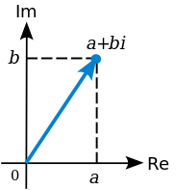
Graphing
How to graph a complex number:

Slide 10
Patterns
What is i¹⁷ ? How about i⁶⁹ ?
What is your strategy? Did you notice a pattern?
i¹ = i
i² = -1
i³ = -i
i⁴ = 1

Slide 11
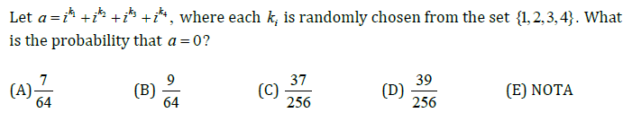
Challenge Problem

