Slide 1
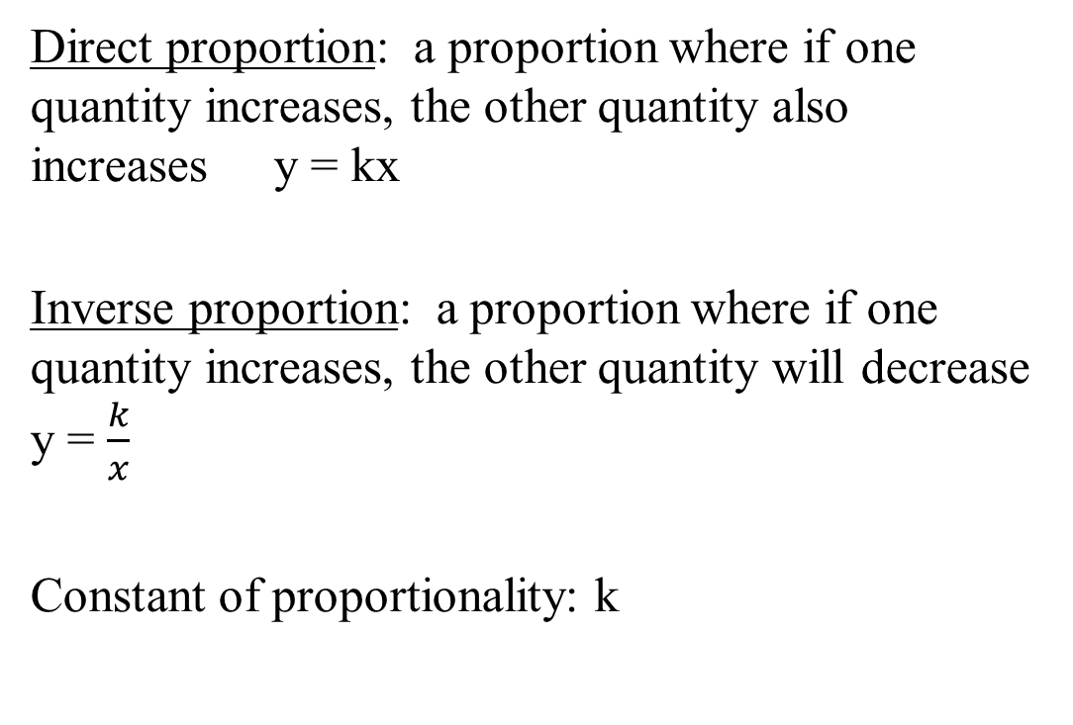
Proportions
Direct proportion: a proportion where if one quantity increases, the other quantity also increases y = kx
Inverse proportion: a proportion where if one quantity increases, the other quantity will decrease y = $\frac{k}{x}$
Constant of proportionality: k

Slide 2
Proportions
Lydia can write 4 pages in 15 mins. At this rate , how many pages can she write in 45 mins?

Slide 3
Example 1
It takes 3 days for 4 people to paint 5 houses. How long will it take 2 people to paint 6 houses?

Slide 4
Conversion Factors
Conversion factors: method of converting from one unit of measurement to another.
Example: If John is 180 cm tall, how tall is he in terms of feet?
(1 in. = 2.54 cm, 1 ft = 12 in)

Slide 5
Conversion Factors
Example 3 : If 4 gleeps are worth 3 glops and 2 glops are worth 5 glips, how many glips are worth the same as 10 gleeps?

Slide 6
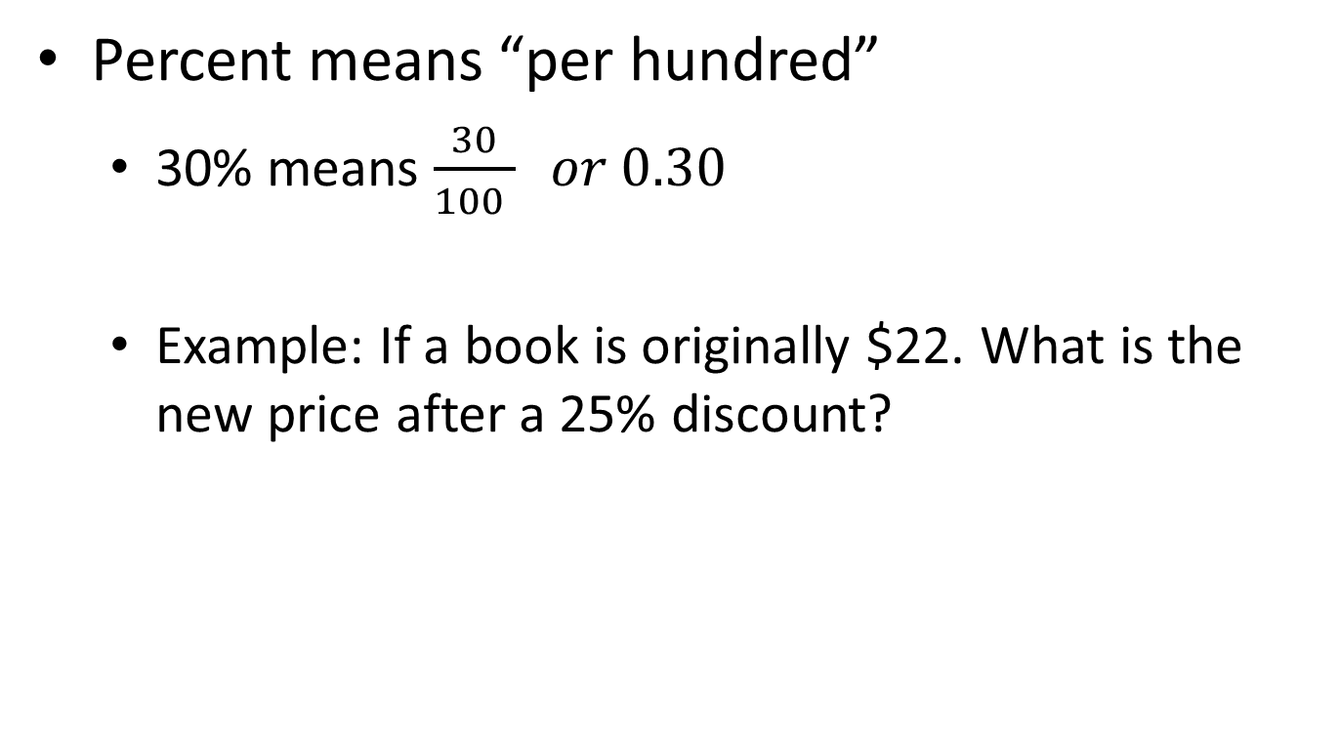
Percent
Percent means “per hundred”
  30% means $\frac{30}{100 } or 0.30$
  Example: If a book is originally $22. What is the new price after a 25% discount?

Slide 7
Percent
Example:
If 2 liters of a 20% acid solution are mixed with 8 liters of a 50% acid solution, what is the concentration of the resulting solution?

